Slide 1
K-Means Clustering and Gaussian Mixture Model
Il-Chul Moon
Dept. of Industrial and Systems Engineering
KAIST
icmoon@kaist.ac.kr

Slide 2
Weekly Objectives
Understand the clustering task and the K-means algorithm
  Know what the unsupervised learning is
  Understand the K-means iterative process
  Know the limitation of the K-means algorithm
Understand the Gaussian mixture model
  Know the multinomial distribution and the multivariate Gaussian distribution
  Know why mixture models are useful
  Understand how the parameter updates are derived from the Gaussian mixture model
Understand the EM algorithm
  Know the fundamentals of the EM algorithm
  Know how to derive the EM updates of a model

Slide 3
K-Means algorithm

Slide 4
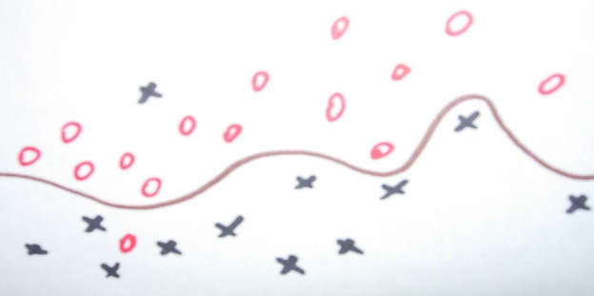
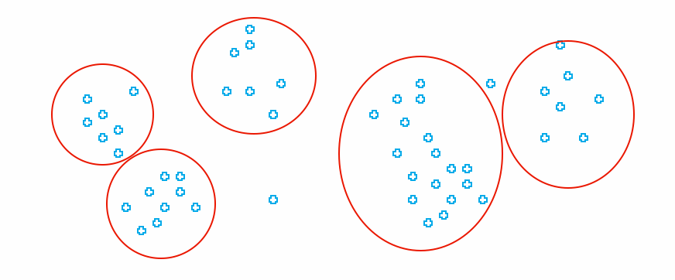
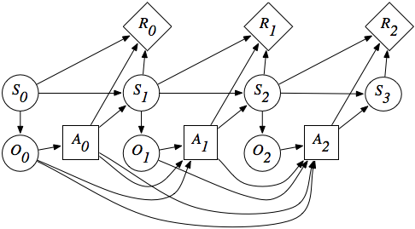
Types of Machine Learning
Machine Learning
…..
Supervised Learning
Unsupervised Learning
Reinforcement Learning
You know the true answers of some of instances
You do not know the true answers of instances
You do know the objective, but you do not know how to achieve
You can
  Machine learning
  Dataset provider
  Machine learning users
  etc
Various classifications by different professors
  Purpose, data types, etc
Other learning classifications also exist

Slide 5
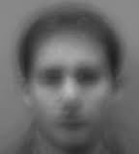
Unsupervised Learning
Unsupervised Learning
You do not know the true answers of instances
You don’t know the true value, and you
cannot provide examples of the true value.
Cases, such as
  Discovering clusters
  Discovering latent factors
  Discovering graph structures
Clustering or filtering or completing of
  Finding the representative topic words from text data
  Finding the latent image from facial data
  Completing the incomplete matrix of product-review scores
  Filtering the noise from the trajectory data
Methodologies
  Clustering: estimating sets and affiliations of instances to the sets
  Filtering: estimating underlying and fundamental signals from the mixture of signals and noises

Slide 6
Clustering Problem
How to assign data points to classes?
→ Clustering
(here classes == clusters)
How to cluster the unlabeled data points?
  No concrete knowledge of their classes
  Latent (hidden) variable of classes
  Optimal assignment to the latent classes
Uncertain area of clustering

Slide 7
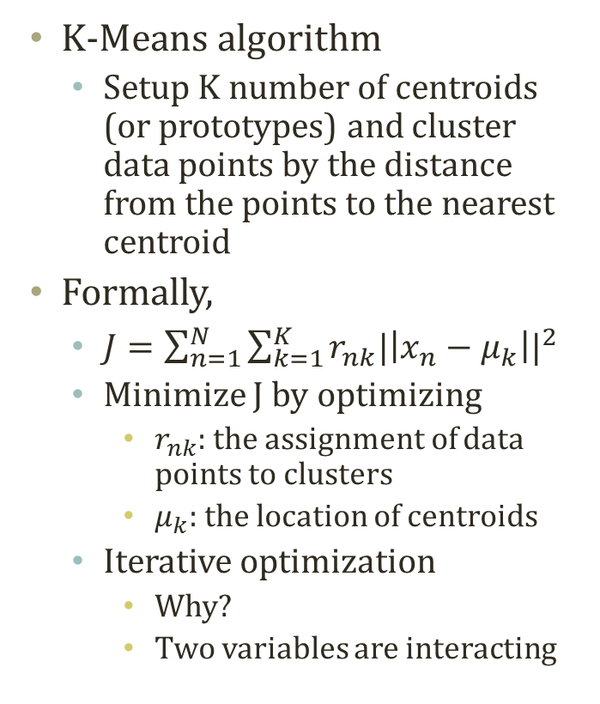
K-Means Algorithm
K-Means! = K-Neareat Neighbor
4 reds and 2 blues → Red!
K-Means algorithm
  Setup K number of centroids (or prototypes) and cluster data points by the distance from the points to the nearest centroid
Formally,
  $J=\sum_{n=1}^{N}{\sum_{k=1}^{K}{r_{nk}{|\left|x_{n}−μ_{k}\right||}^{2}}}$
  Minimize J by optimizing
    $r_{nk}$: the assignment of data points to clusters
    $μ_{k}$: the location of centroids
  Iterative optimization
    Why?
    Two variables are interacting

Slide 8
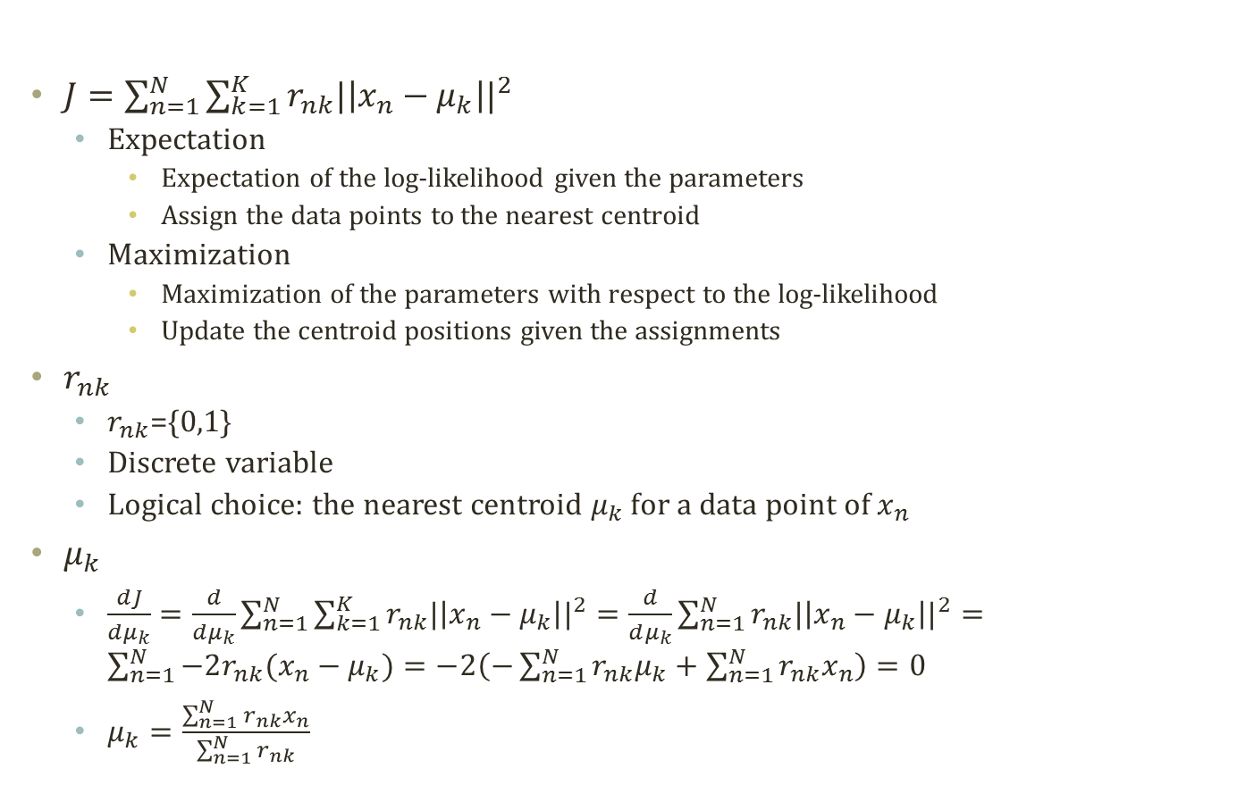
Expectation and Maximization
$J=\sum_{n=1}^{N}{\sum_{k=1}^{K}{r_{nk}{|\left|x_{n}−μ_{k}\right||}^{2}}}$
  Expectation
    Expectation of the log-likelihood given the parameters
    Assign the data points to the nearest centroid
  Maximization
    Maximization of the parameters with respect to the log-likelihood
    Update the centroid positions given the assignments
$r_{nk}$
  $r_{nk}$={0,1}
  Discrete variable
  Logical choice: the nearest centroid $μ_{k}$ for a data point of $x_{n}$
$μ_{k}$
  $\frac{dJ}{dμ_{k}}=\frac{d}{dμ_{k}}\sum_{n=1}^{N}{\sum_{k=1}^{K}{r_{nk}{|\left|x_{n}−μ_{k}\right||}^{2}}}=\frac{d}{dμ_{k}}\sum_{n=1}^{N}{r_{nk}{|\left|x_{n}−μ_{k}\right||}^{2}}=\sum_{n=1}^{N}{−2r_{nk}(x_{n}−μ_{k})}=−2\left(−\sum_{n=1}^{N}{r_{nk}μ_{k}}+\sum_{n=1}^{N}{r_{nk}x_{n}}\right)=0$
  $μ_{k}=\frac{\sum_{n=1}^{N}{r_{nk}x_{n}}}{\sum_{n=1}^{N}{r_{nk}}}$

Slide 9
Progress of
K-Means Algorithm
EM iterations to
  Optimize the assignments with respect to the sum of distances
  Optimize the parameters with respect to the sum of distances

Slide 10
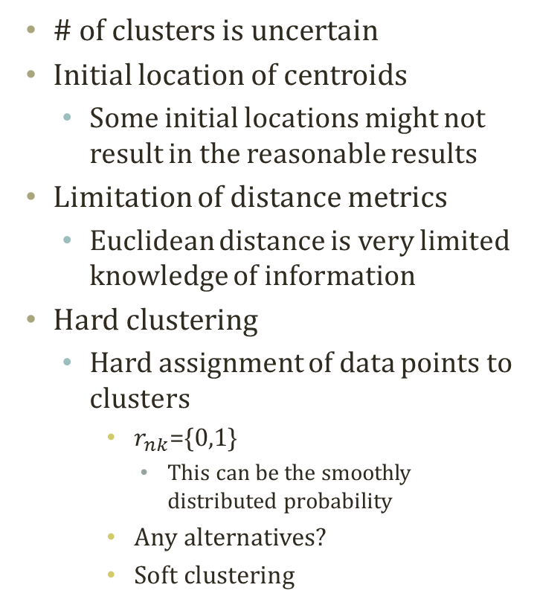
Properties of
K-Means Algorithm
# of clusters is uncertain
Initial location of centroids
  Some initial locations might not result in the reasonable results
Limitation of distance metrics
  Euclidean distance is very limited knowledge of information
Hard clustering
  Hard assignment of data points to clusters
    $r_{nk}$={0,1}
      This can be the smoothly distributed probability
    Any alternatives?
    Soft clustering

